Slide 1
Programming in Java
Module-4
Strings

Slide 2
String, StringBuffer, StringBuilder in Java

Slide 3
Strings
In Java, String is an object of String class that represents a string of characters. For example, “Presidency” is a string of 10 characters.
String class contains several methods, we create objects for String class and we use these methods for manipulation.
The String class is immutable, so that once it is created a String object cannot be changed
ie., if we try to perform any changes to that object, with those changes new obj will be created.
Note: This String class is available in java.lang package.
String is not a primitive data type

Slide 4
Basically, there are three ways to create a String object in Java.
By string literal / constant.
By new keyword.
By converting character arrays into strings
1. String literal in Java is created by using double quotes.
For example: String s1 = “Presi”;
Note: The string literal is always created in the string constant pool (SCP)
In Java, String constant pool is a special area that is used for storing string objects.
For example: String s1 = “Presi”; // compile time
String s2 = “Presi”;
String s3=“University”;
String s4=“Presi”;
Note: whenever a new object is created, String pool first checks whether the object is already present in the pool or not. If it is present, then same reference is returned to the variable else new object will be created in the String pool and the respective reference will be returned. (Refer to the diagrams in the next slides)

Slide 5
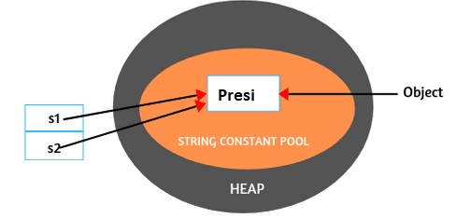
2. Creating String Object by new Keyword:
The second way of creating an object to string class is by using new operator, It can be declared as follows:
String s = new String(“Presi”); // run time
String s3=new String(“Presi”);
Note: Whenever we create an object of string class using the new operator, JVM will create two objects. First, it will create an object in the heap area and one more copy in SCP for future purpose. (Refer to the diagrams in the next slides)

Slide 6
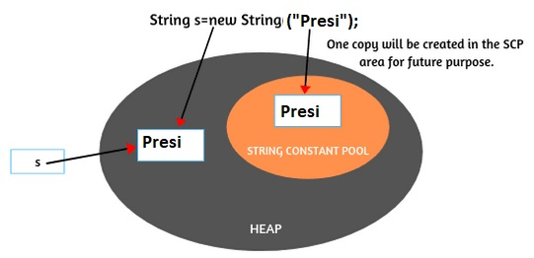
Note : For every string literal, one copy will be created in the SCP area.
3. By converting Character Arrays into String
The third way to create strings is by converting the character arrays into string. Let’s take a character type array: arr[ ] with some characters as given below:
char arr[ ] = {'j','a','v','a'};
Now create a string object by passing array name to string constructor like this:
String s = new String(arr);
Presi
s3

Slide 7
Example
String s1 = “Presidency”;
String s2 = new String(“Presidency”);
String s3 = “Presidency”;
The difference between the three statements is that, s1 and s3 are pointing to the same memory location i.e. the string pool (SCP). s2 is pointing to a memory location on the heap.
Using a new operator creates a memory location on the heap.
Concatenating s1 and s3 leads to creation of a new string in the pool.

Slide 8
String class methods :
Java String provides various methods to perform different operations on strings.
Method | Description | return type
length() | The method returns the length of the string, that is number of characters (Unicode units) in the string. | int
equals() | To check if one string is equal to another (it checks the content of strings while comparing them.) | boolean
equalsIgnoreCase() | Compares two strings (content), ignoring case considerations | boolean
charAt() | Returns the character at the specified index (position) | char
concat() | Appends a string to the end of another string | String
replace() | Returns new string by replacing all occurrences of oldChar with newChar. | String
trim() | Method removes spaces in the beginning and ending. But it doesnot trim (or remove) spaces in the middle. | String

Slide 9
String class methods :
Method | Description | return type
indexOf() | Returns the position of the first found occurrence of specified characters in a string | int
lastIndexOf() | Returns the index within the string of the last occurrence of the specified string. | int
substring() | Returns a new string which is the substring of a specified string | String
compareTo() | Compares two string lexicographically. | int
compareToIgnoreCase() | Compares two string lexicographically, ignoring case considerations. | int
toLowerCase() | Converts a string to lower case letters | String
toUpperCase() | Converts a string to upper case letters | String

Slide 10
Activity: Execute the program and analyze the output
// demo of == operator Vs equals() method
class String1c
{
public static void main(String args[]) {
String s1= new String("Presidency");
String s2= new String("Presidency");
System.out.println(s1==s2);
System.out.println(s1.equals(s2));
}}
O/p: false
true

Slide 11
StringBuffer
StringBuffer is a synchronized and allows us to mutate the string.
ie.,StringBuffer class objects are mutable in java(we can modify, according to our requirement we can change, substrings can be inserted in middle and appended at the end), object initialization is same, the modifications are done in the same location.
Note: String objects are stored in a constant pool whereas, StringBuffer objects are stored on heap memory (that means no SCP).

Slide 12
StringBuffer Constructors
StringBuffer(): The default constructor (the one with no parameters) reserves room for 16 characters without reallocation (empty string, no characters in it).
StringBuffer a =new StringBuffer();
StringBuffer(int size): This is used to create a string buffer whose initial capacity is specified and with no characters. Syntax:
StringBuffer a=new StringBuffer(10);
StringBuffer(String string): Constructs a string buffer initialized to the contents of the specified string.
StringBuffer​(CharSequence seq): Constructs a string buffer that contains the same characters as the specified CharSequence.

Slide 13
StringBuffer class methods:
Capacity: The total number of characters hold in the StringBuffer object is called capacity.
Note: 16 is the default capacity. The capacity increases by increasing the number of characters. The new capacity = (current capacity+1)*2.
If the current capacity is 16, the new capacity will be (16+1)*2=34.
If 34 capacity is also completed then new capacity =(current capacity +1)*2 = (34+1)*2 = 70.
Length: The number of characters already present in the StringBuffer object is called length.

Slide 14
StringBuffer class methods:
append(): This method concatenates the string representation of any other type of data to the end of the invoking StringBuffer object. It has several overloaded versions.
insert() : This method inserts one string into another.
StringBuffer insert(int index, String str)
StringBuffer insert(int index, int num)
reverse(): This method reverses the characters within a StringBuffer object.

Slide 15
Activity : Execute the program and analyze the o/p
public class StringBuffer1 {
public static void main(String[ ] args) {
StringBuffer sb = new StringBuffer(); // creating StringBuffer object
int length = sb.length();
int capacity = sb.capacity();
System.out.println("Before adding any character:");
System.out.println("Length = " +length); // length = 0
System.out.println("Default initial capacity = " +capacity); // Capacity = 16
// Adding 16 characters in the existing string buffer object.
sb.append("abcdefghijklmnop");

Slide 16
System.out.println("After adding 16 characters:");
System.out.println("Length = " +sb.length()); // now length is 16.
System.out.println("Capacity = " +sb.capacity()); // still capacity is 16.
// Now add the 17th character in the existing string buffer object.
sb.append("q");
System.out.println("After adding 17th character:");
System.out.println("Length = " +sb.length());
System.out.println("Capacity = " +sb.capacity());
} }
o/p ????

Slide 17
replace()
This method replaces the string from specified start index to the end index.
Example:
StringBuffer sb = new StringBuffer("I love India");
System.out.println(sb);
sb.replace(2,6, "LOVE");
System.out.println(sb);

Slide 18
StringBuilder
StringBuilder is the same as the StringBuffer class
StringBuilder is not synchronized, which in turn means it is not thread-safe
Synchronization : By default, the StringBuffer is synchronized, whereas StringBuilder doesn’t have any synchronization. In cases where the string has to be accessed by multiple threads and no external synchronization is applied, you must use StringBuffer and not StringBuilder.

Slide 19
Note: Methods used in StringBuffer & StringBuilder are same.
Self Study :
Refer remaining methods in StringBuffer class, most of them are self explanatory.

